Slide 1
Money

Slide 2
Fixed and Variable Costs
Total Costs
Total Fixed Costs (TFC)
Total Variable Costs (TVC)
Total Costs (TC)
TC = TFC + TVC
Average Costs
Average Fixed Costs (AFC)
Average Variable Costs (AVC)
Average Total Costs (ATC)
ATC = AFC + AVC

Slide 3
Average and Marginal Costs

Slide 4
Average and Marginal Costs
Marginal Cost
Marginal cost (MC) measures the increase in total cost that arises from an extra unit of production.
Marginal cost helps answer the following question:
How much does it cost to produce an additional unit of output?

Slide 5
Average and Marginal Cost

Slide 6
The many types of cost: A summary
Term | Definition | Mathematical Description
Explicit costs Implicit costs Fixed costs Variable costs Total cost Average fixed cost Average variable cost Average total cost Marginal cost | Costs that require an outlay of money by the firm Costs that do not require an outlay of money by the firm Costs that do not vary with the quantity of output produced Costs that vary with the quantity of output produced The market value of all the inputs that a firm uses in production Fixed cost divided by the quantity of output Variable cost divided by the quantity of output Total cost divided by the quantity of output The increase in total cost that arises from an extra unit of production | FC VC TC = FC + VC AFC = FC / Q AVC = VC / Q ATC = TC / Q MC = ΔTC / ΔQ

Slide 7
Note how Marginal Cost changes with each change in Quantity.

Slide 8
Table

Slide 9
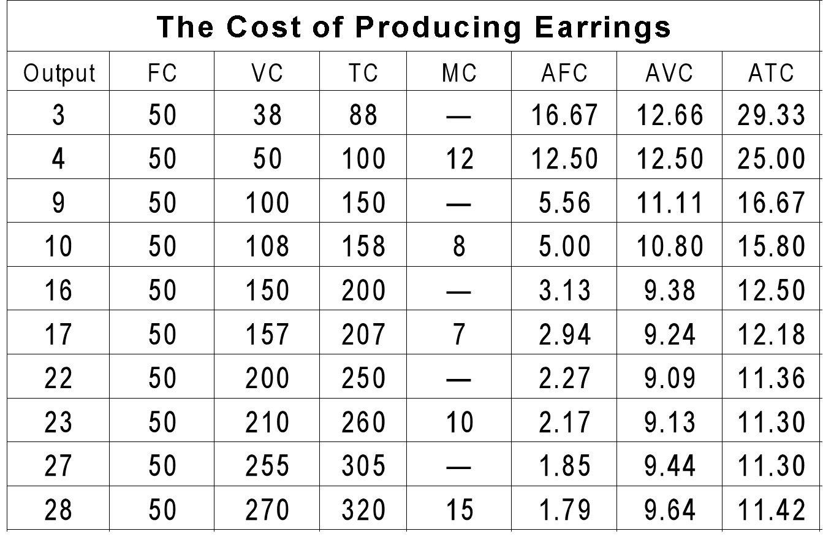

Slide 10
Total Cost Curves
TC
$400
VC
350
300
TC = (VC + FC)
250
Total cost
200
L
150
O
100
M
50
FC
0
2
4
6
8
10
20
30
Quantity of earrings

Slide 11
Per Unit Cost Curves
$30
28
26
24
22
20
18
16
MC
14
Cost
12
ATC
10
AVC
8
6
4
2
AFC
0
2
4
6
8
10
12
14
16
18
20
22
24
26
28
30
32
Quantity of earrings

Slide 12
Relationship Between Marginal and Average Costs
The marginal cost and average cost curves are related.
When marginal cost exceeds average cost, average cost must be rising.
When marginal cost is less than average cost, average cost must be falling.

Slide 13
Relationship Between Marginal and Average Costs
This relationship explains why marginal cost curves always intersect average cost curves at the minimum of the average cost curve.

Slide 14
Relationship Between Marginal and Average Costs
To summarize:
If MC > ATC, then ATC is rising.
If MC = ATC, then ATC is at its minimum.
If MC < ATC, then ATC is falling.

Slide 15
MARGINAL COSTING

Slide 16
COST
VARIABLE COST
SEMI VARIABLE COST
Fixed cost
DEPENDS ON PRODUCTION
PARTLY FIXED And partly variable
DOES NOT DEDEPENDS ON production
Direct material
Direct Labour
Direct expenses
Electric bill
Telephone bill
Rent

Slide 17
“Marginal costing is technique to estimate incremental cost for incremental production”

Slide 18
INCOME STATEMENT
Particulars | Amount
Sales | Xx
(-) Variable cost | (x)
Contribution | Xx
(-) Fixed cost | (x)
Net Profit | Xx

Slide 19
Profit/Volume Ratio = Contribution
(P/V) Sales
Break even Point (UNITS) = fixed cost .
Contribution Per unit
Break even Point (Rs.) = fixed cost
P/V Ratio
Estimated Sales (Units) = fixed cost + Expected Profit
Contribution Per unit

Slide 20
Estimated Sales (Rs.) = fixed cost + Expected Profit
P/V Ratio
Marginal of safety (Units) = Es (units) – B.E.P (Units)
Marginal of safety (Rs.) = Es (Rs.) – B.E.P (Rs.)
Marginal of safety (Rs.) = Net Profit
P/V Ratio
P/V Ratio = Different in profit
Different in sales

Slide 21
Capital appraisal methods
Accounting Rate of Return (ARR)
Profits
Payback
Cash flows
Net Present Value (NPV)
Cash flows
Internal Rate of Return (IRR)
Cash flows

Slide 22
Capital appraisal methods
The accounting rate of return is based on the use of operating profit. The operating profit of a project is the difference between revenues earned by the project, less all the operating costs associated with the project, including depreciation.
All other appraisal methods use net cash flows as the basis for appraising capital projects. This is due to the nature of assessing capital investment projects where one must spend cash now and reap the cash rewards later.
The calculation of accounting profit is not concerned with the timing of cash flows. This is due to its adherence to the accruals concept whereby profits are calculated by deducting expenses charged from revenues earned.

Slide 23
Net cash flow
Net cash flow =
operating cash flows + / - capital cash flows

Slide 24
Net profit and net cash flow
Net profit |  | Net cash flow
Related revenue earned less |  | Related cash inflows (operating + capital) less
All related costs (including depreciation) equals |  | Related cash outflows (operating + capital) (NOT including depreciation) equals
Profit |  | Net cash flow

Slide 25
Accounting rate of return (ARR)
The accounting rate of return method calculates the estimated overall profit or loss on an investment project and relates that profit to the amount of capital invested and to the period for which it is required.
A business will have a required minimum rate of return for any investment. This is related to the cost of capital of the business.
If an investment yields a return greater than the cost of capital, then the investment would be considered suitable and profitable.
The accounting rate of return is an average rate of return calculated by expressing average annual profit as a percentage of the average value of the investment.

Slide 26
Accounting rate of return (ARR)
ARR = Average annual profit Average investment
Average annual profit Total project profit after depreciation and before interest, tax and dividends, divided by the estimated life of the project. |  | Average investment Initial investment, plus value of investment at project-end, divided by two.

Slide 27
Accept or reject criteria for ARR method
Accept the project | Reject the project
Project ARR greater than the minimum required return. | Project ARR less than the minimum required return.

Slide 28
Advantages of ARR
It takes account of the overall profitability of the project.
It is simple to understand and easy to use.
Its end result is expressed as a percentage, allowing projects of differing sizes to be compared.

Slide 29
Disadvantages of ARR
It is based on accounting profits rather than cash flows.
The ARR does not take into account the timing of cash flows.
The ARR does not take into account the time value of money. It does not take into account the cost of waiting to recoup the investment.
The ARR takes no account of the size of the initial investment.

Slide 30
The payback method
This method of investment appraisal simply asks the question ‘how long before I get my money back?’
How quickly will the cash flows arising from the project exactly equal the amount of the investment.
It is a simple method, widely used in industry and is based on management’s concern to be reimbursed on the initial outlay as soon as possible.
It is not concerned with overall profitability or the level of profitability.

Slide 31
Computing payback for the project
Do we accept or reject the project?
Notes:
The payback period is year 3, if you assume that the cash flows occur at the end of the year as we do with all of the other decision rules.
If we assume that the cash flows occur evenly throughout the year, then the project pays back in 2.34 years.

Slide 32
Accept or reject criteria for payback method
Accept the project | Reject the project
Payback period is less than that required by investors. | Payback period is greater than that required by investors.

Slide 33
Advantages of payback
It is simple to understand and apply.
It promotes a policy of caution in investment.

Slide 34
Disadvantages of payback
It takes no account of the timing of cash flows (€100 received today is worth more than €100 received in 12 months time).
It is only concerned with how quickly the initial investment is recovered and thus it ignores the overall profitability and return on capital for the whole project.

Slide 35
Time value of money
The time value of money concept plays an important role in appraising capital projects because the time lag between the initial investment and payback can be quite long.
€1 earned or spent sooner, is worth more than €1 earned or spent later.
To evaluate any project taking into account the time value of money, the cash flows received in the future must be reduced or discounted to a present value, so that all relevant cash flows are denominated in todays value (present value).

Slide 36
The cost of capital
All investment projects require funding. Generally, funding can be classified into:
Equity funding, where investors buy an equity or ownership share in a project. This is done through the issue of shares or by retaining profits in the business.
Debt, where the company can borrow or issue its own debentures.
Each source of finance has a cost. The cost of debt is the interest rate that applies to the debt. The costs of equity finance are the dividends and increases in share price expected by shareholders.
This cost of capital becomes the benchmark or minimum required return on a project.
A project is only truly profitable when its actual return on assets is greater than the company’s cost of capital.

Slide 37
Discounted cash flow (DCF)
DCF is the investment appraisal technique that takes account of the time value of money.
DCF looks at the cash flows of a project, not the accounting profits. It is concerned with liquidity not profitability.
The timing of cash flows is taken into account by discounting all future cash flows to present value.
The effect of discounting is to give a bigger value per euro for cash flows that occur earlier.
The discount factor to use is the cost of capital to the business.

Slide 38
Net present value (NPV)
Present value can be defined as the cash equivalent now of a sum of money to be received or paid at a stated future date, discounted at a specified cost of capital.
The net present value is the value obtained by discounting all the cash outflows and inflows of a capital investment project, at a chosen target rate of return or cost of capital.
The present value of the cash inflows, minus the present value of the cash outflows, is the net present value.

Slide 39
Net present value (NPV)
If the NPV is positive, it means that the cash inflows from the investment will yield a return in excess of the cost of capital and thus the project should be undertaken, as long as there are no other projects offering a higher NPV.
If the NPV is negative, it means that the cash inflows from the investment yield a return below the cost of capital and so the project should not be undertaken.
If the NPV is exactly zero, the cash inflows from the investment will yield a return which is exactly the same as the cost of capital and thus the project may or may not be worth undertaking depending on other investment opportunities available.

Slide 40
The Net Present Value Method
Notes:
The net present value is interpreted as follows:
If the net present value is positive, then the project is acceptable.
If the net present value is zero, then the project is acceptable.
If the net present value is negative, then the project is not acceptable.

Slide 41
Net Present Value
The difference between the market value of a project and its cost
Discounted Cash Flow (DCF) Valuation:
The first step is to estimate the expected future cash flows.
The second step is to estimate the required return for projects of this risk level.
The third step is to find the present value of the cash flows and subtract the initial investment.

Slide 42
NPV – Decision Rule
If the NPV is positive, accept the project
A positive NPV means that the project is expected to add value to the firm and will therefore increase the wealth of the owners.
Since our goal is to increase owner wealth, NPV is a direct measure of how well this project will meet our goal.

Slide 43
Computing NPV for the Project
You are looking at a new project and you have estimated the following cash flows:
Year 0: CF = -165,000
Year 1: CF = 63,120;
Year 2: CF = 70,800;
Year 3: CF = 91,080;
Your required return for assets of this risk is 12%.
NPV = 63,120/(1.12) + 70,800/(1.12)² + 91,080/(1.12)³ – 165,000 = 12,627.42
Do we accept or reject the project?

Slide 44
Accept or reject criteria for NPV method
Accept the project | Reject the project
NPV is positive. In choosing between mutually exclusive projects, accept the project with the highest NPV. | NPV is negative.

Slide 45
Advantages of NPV
It takes into account the time value of money.
Profit and the difficulties of profit measurement are excluded.
Using cash flows emphasises the importance of liquidity.
It is easy to compare the NPV of different projects.

Slide 46
Disadvantages of NPV
It is not as easily understood as the payback and accounting rate of return.
It requires knowledge of the company’s cost of capital, which is difficult to calculate.

Slide 47
Appraisal methods
Non time based
Accounting Rate of Return (ARR)
Profits
Payback
Cash flows
Time based (DCF)
Net Present Value (NPV)
Cash flows
Internal Rate of Return (IRR)
Cash flows

Slide 48
Appraisal methods
Of the four appraisal methods presented, it is clear that the discounted cash flow methods (NPV and IRR) have a distinct advantage over the payback and accounting rate of return methods because they are cash based and they take the time value of money into account.
The NPV approach is considered superior to the IRR because of the disadvantages associated with the IRR method.
However it is clear that there is a place for all four methods, which inform judgement, not replace it.

Slide 49
Discounted payback
One of the weaknesses of the payback period is that it does not take into account the cost of waiting. The discounted payback method overcomes this by simply discounting the cash flows of a project with the cost of capital for the business and calculating the payback period based on the present value of the cash flows.

Slide 50
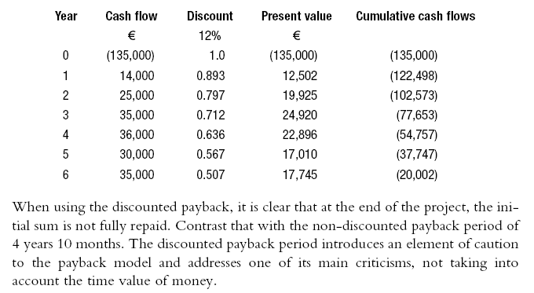
Discounted payback
Newport Leisure Park Ltd. – discounted payback

Slide 51
Depreciation Expense Factors
-
Initial Cost
Residual Value
=
Depreciable Cost
Useful Life
1
2
3
4
5
Periodic Depreciation Expense

Slide 52
Use of Depreciation Methods
Other
Units-of-Production
Declining- Balance
8%
5%
4%
83%
Straight-Line
Source: Accounting Trends & Techniques, 56th. ed., American Institute of Certified Public Accountants, New York, 2002.

Slide 53
Facts
Original Cost.....………….. $24,000
Estimated Life in years….. 5 years
Estimated Life in hours….. 10,000
Estimated Residual Value... $2,000

Slide 54
Straight-Line Method
Cost – estimated residual value
Estimated life
= Annual depreciation

Slide 55
Straight-Line Method
$24,000 – $2,000
5 years
= $4,400 annual depreciation

Slide 56
Straight-Line Rate
$24,000 – $2,000
= $4,400
5 years
$4,400
= 18.3%
$24,000

Slide 57
Straight-Line Method
The straight-line method is widely used by firms because it is simple and it provides a reasonable transfer of cost to periodic expenses if the asset is used about the same from period to period.

Slide 58
Straight-Line Method
Accum. Depr. Book Value Depr. Book Value at Beginning at Beginning Expense at End Year Cost of Year of Year for Year of Year
1 $24,000 $24,000 $4,400 $19,600
2 24,000 $ 4,400 19,600 4,400 15,200
3 24,000 8,800 15,200 4,400 10,800
4 24,000 13,200 10,800 4,400 6,400
5 24,000 17,600 6,400 4,400 2,000
Cost ($24,000) – Residual Value ($2,000)
Annual Depreciation
Expense ($4,400)
=
Estimated Useful Life (5 years)

Slide 59
Units-of-Production Method
Cost – estimated residual value
Estimated life in units, hours, etc.
= Depreciation per unit, hour, etc.

Slide 60
Units-of-Production Method
$24,000 – $2,000
10,000 hours
= Depreciation per unit, hour, etc.
= $2.20 per hour

Slide 61
Units-of-Production Method
The units-of-production method is more appropriate than the straight-line method when the amount of use of a fixed asset varies from year to year.

Slide 62
Declining-Balance Method
Step 1
Ignoring residual value, determine the straight-line rate
$24,000 – $2,000
= $4,800
5 years
$4,800
= 20%
$24,000

Slide 63
Declining-Balance Method
There’s a shortcut. Simply divide one by the number of years (1 ÷ 5 = .20).

Slide 64
Declining-Balance Method
Step 2
Double the straight-line rate.
.20 x 2 = .40
For the first year, the cost of the asset is multiplied by 40 percent. After the first year, the declining book value of the asset is multiplied 40 percent.

Slide 65
Declining-Balance Method
Step 3
Build a table.

Slide 66
Declining-Balance Method
Book Value Accum.
Beginning Annual Deprec. Book Value
Year of Year Rate Deprec. Year-End Year-End
1 $24,000 40% $9,600
$24,000 x .40

Slide 67
Declining-Balance Method
Book Value Accum.
Beginning Annual Deprec. Book Value
Year of Year Rate Deprec. Year-End Year-End
1 $24,000 40% $9,600 $9,600 $14,400

Slide 68
Declining-Balance Method
Book Value Accum.
Beginning Annual Deprec. Book Value
Year of Year Rate Deprec. Year-End Year-End
1 $24,000 40% $9,600 $9,600 $14,400
2 14,400 40% 5,760
$14,400 x .40

Slide 69
Declining-Balance Method
Book Value Accum.
Beginning Annual Deprec. Book Value
Year of Year Rate Deprec. Year-End Year-End
1 $24,000 40% $9,600 $9,600 $14,400
2 14,400 40% 5,760 15,360 8,640

Slide 70
Declining-Balance Method
Book Value Accum.
Beginning Annual Deprec. Book Value
Year of Year Rate Deprec. Year-End Year-End
1 $24,000 40% $9,600 $9,600 $14,400
2 14,400 40% 5,760 15,360 8,640
3 8,640 40% 3,456 18,816 5,184

Slide 71
Declining-Balance Method
Book Value Accum.
Beginning Annual Deprec. Book Value
Year of Year Rate Deprec. Year-End Year-End
1 $24,000 40% $9,600 $9,600 $14,400
2 14,400 40% 5,760 15,360 8,640
3 8,640 40% 3,456 18,816 5,184
4 5,184 40% 2,074 20,890 3,110

Slide 72
Declining-Balance Method
Book Value Accum.
Beginning Annual Deprec. Book Value
Year of Year Rate Deprec. Year-End Year-End
STOP!
1 $24,000 40% $9,600 $9,600 $14,400
2 14,400 40% 5,760 15,360 8,640
3 8,640 40% 3,456 18,816 5,184
4 5,184 40% 2,074 20,890 3,110
5 3,110 40% 1,244 22,134 1,866

Slide 73
Declining-Balance Method
If we use this approach in Year 5, we will end the year with a book value of $1,866. Remember, the residual value at the end of Year 5 is expected to be $2,000, so we must modify our approach.
Book Value Accum.
Beginning Annual Deprec. Book Value
Year of Year Rate Deprec. Year-End Year-End
1 $24,000 40% $9,600 $9,600 $14,400
2 14,400 40% 5,760 15,360 8,640
3 8,640 40% 3,456 18,816 5,184
4 5,184 40% 2,074 20,890 3,110
5 3,110 40% 1,244 22,134 1,866

Slide 74
Declining-Balance Method
Book Value Accum.
Beginning Annual Deprec. Book Value
Year of Year Rate Deprec. Year-End Year-End
1 $24,000 40% $9,600 $9,600 $14,400
2 14,400 40% 5,760 15,360 8,640
3 8,640 40% 3,456 18,816 5,184
4 5,184 40% 2,074 20,890 3,110
5 3,110 --- 1,110
$3,110 – $2,000

Slide 75
Declining-Balance Method
Book Value Accum.
Beginning Annual Deprec. Book Value
Year of Year Rate Deprec. Year-End Year-End
1 $24,000 40% $9,600 $9,600 $14,400
2 14,400 40% 5,760 15,360 8,640
3 8,640 40% 3,456 18,816 5,184
4 5,184 40% 2,074 20,890 3,110
5 3,110 --- 1,110 22,000 2,000
Desired ending book value

Slide 76
Comparing Straight-Line With the Declining-Balance Method
Straight-Line
Method
Declining-Balance
Method
5,000
4,000 3,000
2,000 1,000
0
Depreciation ($)
1 2 3 4
1 2 3 4
Life (years)
Life (years)

Slide 77
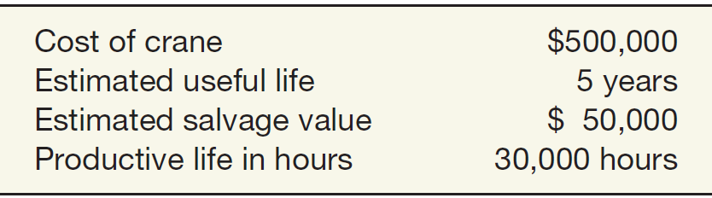
Depreciation - Method of Cost Allocation
Decreasing-Charge Methods
Illustration 11-2
Stanley Coal Mines Facts
Sum-of-the-Years’-Digits. Each fraction uses the sum of the years as a denominator (5 + 4 + 3 + 2 + 1 = 15). The numerator is the number of years of estimated life remaining as of the beginning of the year.
Alternate sum-of-the-years’ calculation
n(n+1)
5(5+1)
=
=
15
2
2
LO 3

Slide 78
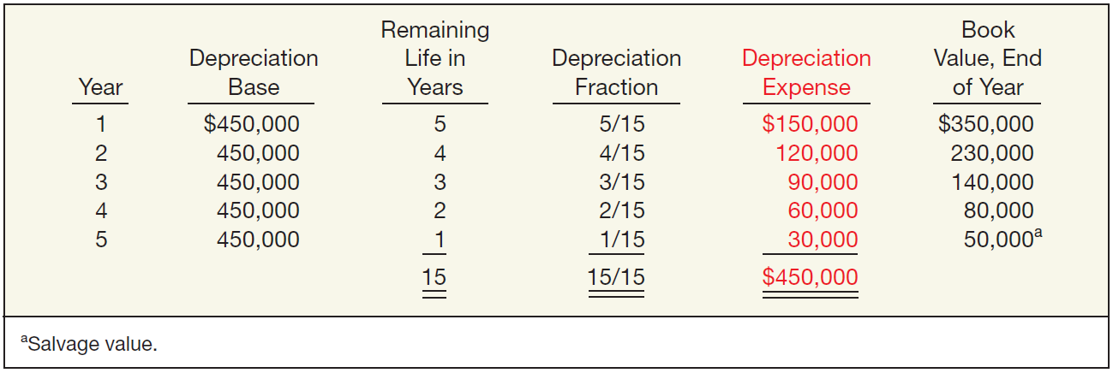
Depreciation - Method of Cost Allocation
Sum-of-the-Years’-Digits
Illustration 11-6
LO 3 Compare activity, straight-line, and decreasing-charge methods of depreciation.

Slide 79
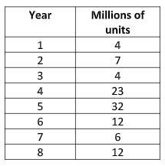
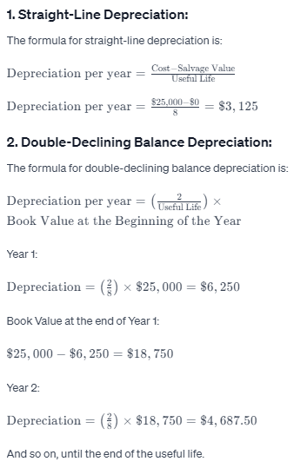
Consider a piece of equipment that costs $25,000 and has an estimated useful life of 8 years and a
$0 salvage value. It has an estimated total unit production of 100 million and the production
schedule is as follows:
Calculate the depreciation amounts using straight line, double-declining balance, units of production
and sum-of-year-digits methods.

Slide 80
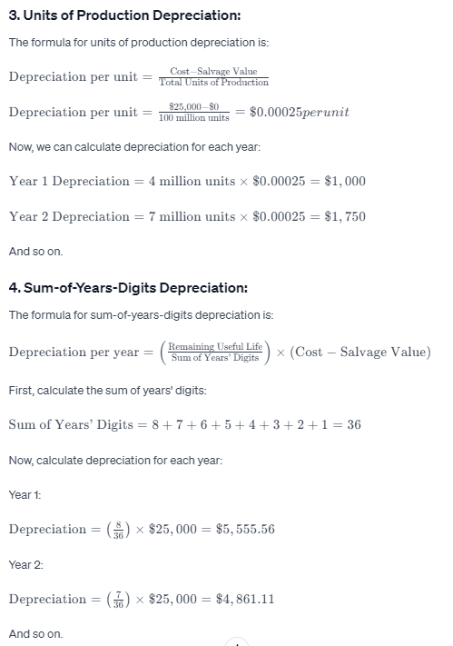

Slide 81
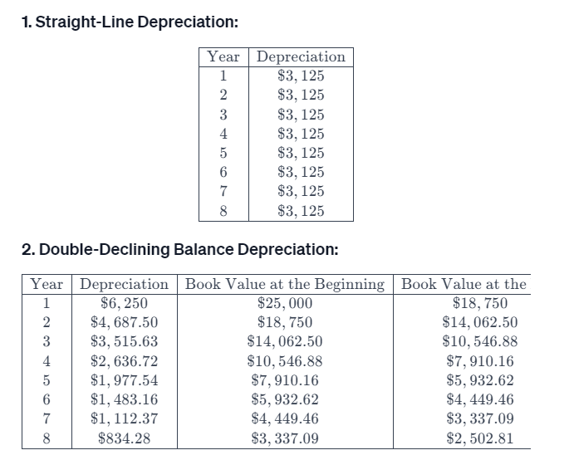
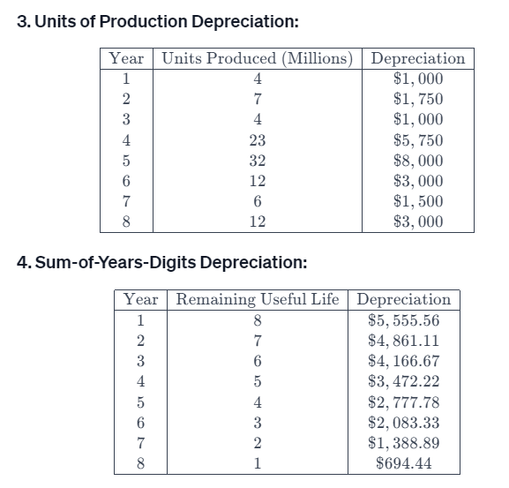

Slide 82
Figure 2.1
Notes:
Figure 2.1 – Sources of New Venture Financing
Black shading indicates primary focus of investor type. Gray shading indicates secondary focus, or focus of a subset of investors.

Slide 83
Sources of New Venture Financing: Bootstrap Financing
Financing that does not depend on an investor’s assessment of the merits of the opportunity or on the value of the assets of the venture
May be from entrepreneur’s own resources or from friends and family
personal savings (90%)
credit card/personal loans (28%)
loans from family and friends (7%)
equity investment from family and friends (5%)

Slide 84
Sources of New Venture Financing: Angel Investors
Individual freelance investors usually interested in investing fairly small amounts ($25,000 - $500,000) in early-stage ventures
Willing to invest over long horizons
Evolved to a quasi-institutional form with angels acting as groups and may co-invest
Often bring significant industry experience and are interested in active involvement

Slide 85
Sources of New Venture Financing: Venture Capital
Venture Capital (VC) funds are organized as limited partnerships
Limited partners (LPs) provide most of the capital
General partner (GP) is responsible for managing the fund, including investment selection, working with entrepreneurs, and harvesting the investments
Focused on equity investment in high-risk ventures with large potential return

Slide 86
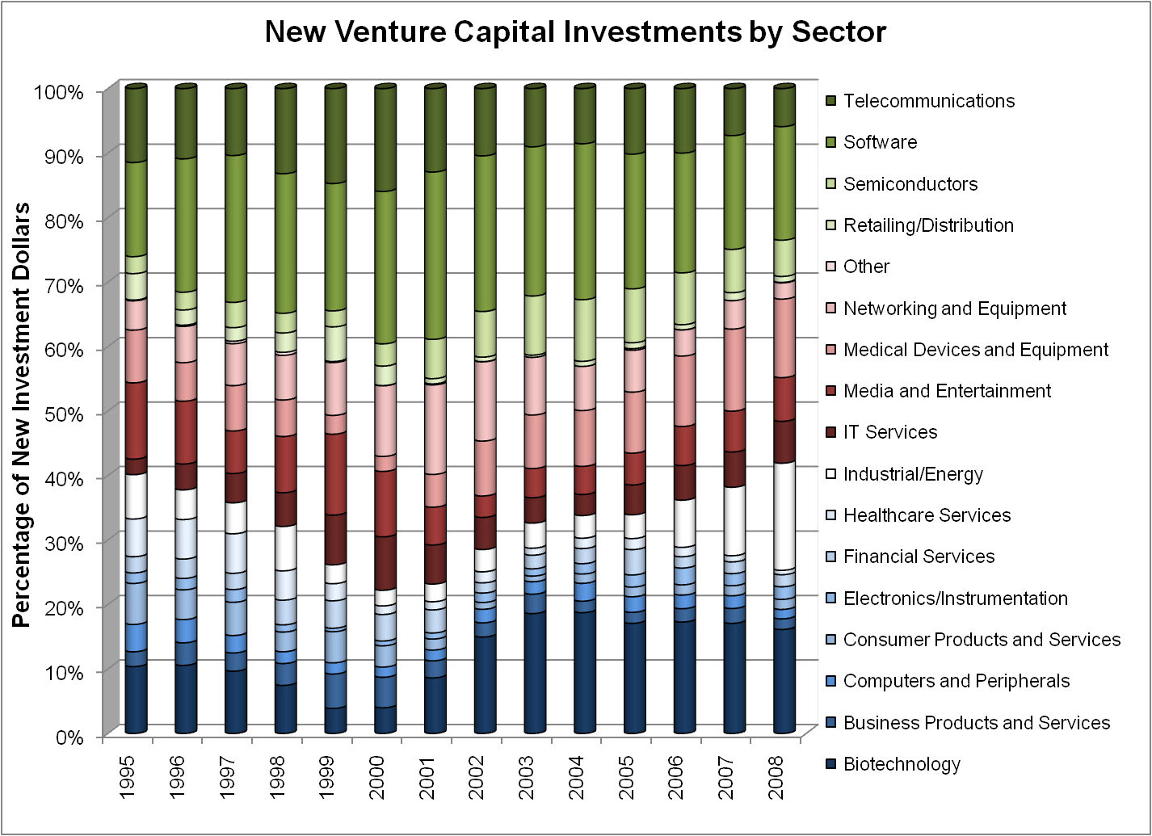
Figure 2.2
Notes:
Figure 2.2 – New Venture Capital Investments by Sector
Source: PricewaterhouseCoopers/National Venture Capital Association MoneyTree™ Report, Data: Thomson Reuters.

Slide 87
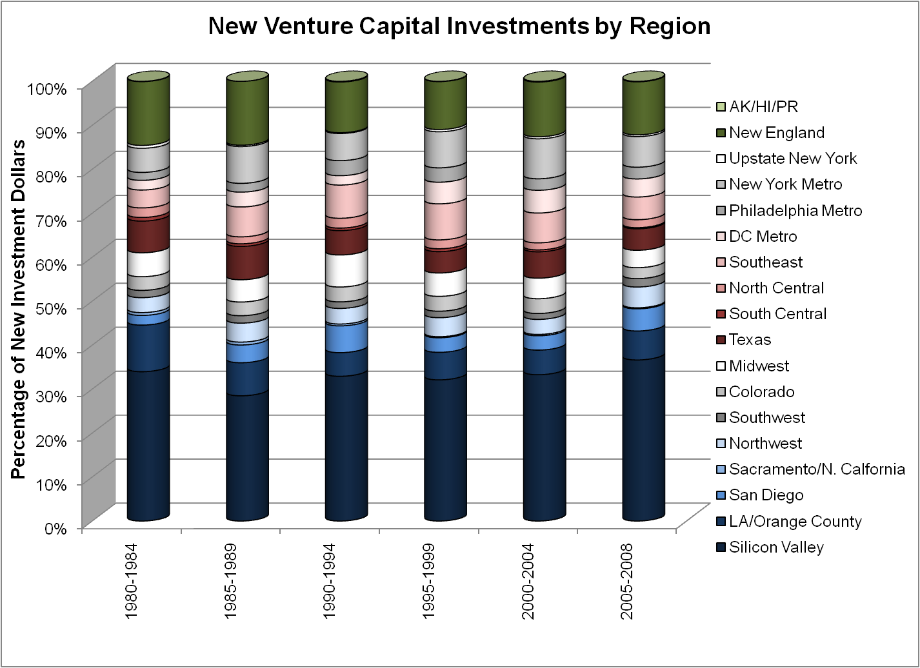
Figure 2.3
Notes:
Figure 2.3 – New Venture Capital Investments by Region
Source: PricewaterhouseCoopers/National Venture Capital Association MoneyTree™ Report, Data: Thomson Reuters.

Slide 88
Sources of New Venture Financing: Asset-Based Lenders
Asset-based lenders, or “secured lenders,” provide debt capital to businesses that have assets that can serve as collateral
rely on the ability to liquidate business assets for debt servicing if necessary (rather than cash flow)
estimated at $590 billion in 2008 in the United States

Slide 89
Sources of New Venture Financing: Venture Leasing
An entrepreneur who requires tangible assets can lease, rather than purchase them
Usually involves assets that are key to the operation of the venture
The lessor’s return may be tied to the financial performance of the venture
Tax advantages to leasing as compared to owning

Slide 90
Sources of New Venture Financing: Corporate Venturing
Can be internally or externally managed
Internally managed venture investing
more likely to occur in firms that depend on innovation to sustain competitive advantage
attempts to keep good ideas from “escaping”
Externally managed venture investing
may seek only financial returns or strategic investments

Slide 91
Figure 2.4
Notes:
Figure 2.4 – Corporate VC Investment as a Percentage of Total VC Investment
The figure shows total new VC commitments by VC funds, including corporate funds. It also plots corporate VC as a percentage of total commitments.
Source: PricewaterhouseCoopers/National Venture Capital Association MoneyTree™ Report, Data: Thomson Reuters.

Slide 92
Sources of New Venture Financing: Government Programs
Many countries have established agencies to support small business formation and growth
The US Small Business Administration (SBA) funds entrepreneurship via
loan guarantee programs
Small Business Investment Companies (SBIC)
Small Business Innovation Research Program (SBIR)
Research grants – National Science Foundation, National Institutes of Health

Slide 93
Sources of New Venture Financing: Trade Credit
Trade credit, or vendor financing arises whenever a business makes a purchase from a supplier that offers payment terms
Terms are usually industry-specific
Largest source of external short-term financing for firms in the US
More important in emerging economies, where risk capital is often scarce

Slide 94
Sources of New Venture Financing: Factoring
A factor buys accounts receivable of the venture and manages the collection activities
Factoring comes in two basic types
with recourse
without recourse
Basic elements of a factoring transaction
advance: 70 to 90% of face value of receivables
reserve: a portion held back if with recourse
fees: 2 to 6% for handling, lending, and risk

Slide 95
Figure 2.5
Notes:
Figure 2.5 – Global Growth of Factoring As a Source of Financing
Source: Factor Chain International: http://www.factors-chain.com/.

Slide 96





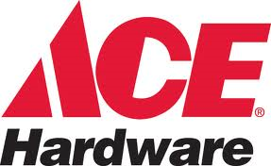
Sources of New Venture Financing: Franchising
Franchising can enable a business concept to grow rapidly by using capital from franchisees
Franchisor establishes a business format and offers franchising opportunities to prospective franchisees
Examples:

Slide 97
Sources of New Venture Financing: Mezzanine Capital
Capital raised after the firm has established a record of positive net income with revenues approaching $10 million or more
subordinated debt or preferred equity
a hybrid of senior debt and common equity “sweeteners”
often provided by some VC firms or other private equity funds

Slide 98
Sources of New Venture Financing: Debt
Pros
interest is tax deductible
debt is usually less expensive than equity
no loss of control
Cons
cash flow required for interest and principal payments
senior to equity and has contractual rights in the case of financial distress

Slide 99
Sources of New Venture Financing: Private Placements
Both equity and debt can be issued via “private placement”
Examples: VC and angel investments
Benefits
can be faster and less expensive than a public offering
limits disclosure of strategic information
facilitates monitoring

Slide 100
Sources of New Venture Financing: Initial Public Offering (IPO)
First sale of equity to public investors
IPOs provide a very small fraction of overall new venture funding
Provides exit for VCs and other investors in high-risk, high-growth ventures
Company raises capital by selling registered equity shares to the public via a formal offering process

Slide 101
Sources of New Venture Financing: Initial Public Offering (IPO)
Pros
establishes outside market for the venture’s shares
investor feedback on managerial decisions
can be used to effect acquisitions
employee stock incentives
large amounts of capital can be raised
Cons
relatively expensive
disclosure requirements
focus on short-term earnings

Slide 102
Sources of New Venture Financing: Direct Public Offering
SEC regulations provide “safe harbors”
Fall between private and public offering
Firm issues equity to small numbers of “sophisticated” investors
No formal public offering process
Shares may eventually become freely tradable

Slide 103
What’s Different about Financing Social Ventures?
Unable to issue equity
Financing through
structured debt
royalty-based financing or revenue rights
philanthropic funding
may allow investors to make tax-deductible contributions to “giving funds”
philanthropic angel investors
social VC funds

Slide 104
Considerations When Choosing Financing
Are not-for-profit status and the attendant tax exemption worthwhile?
Should liability be limited, or should losses be passed on to the company’s owners?
Is it important to be able to switch corporate forms easily as the company evolves?
How important is it to avoid corporate-style taxation (i.e., double taxation)?
Who are the best monitors of the firm-owners, investors, or managers?
How will the monitors be monitored?

Slide 105
Considerations When Choosing Financing
Table 2.1
Notes:
Table 2.1– Common Organizational Forms in the US

Slide 106
Investor expectation in entreprenurship development in terms of money, cost profit and finanace
Investors in entrepreneurship development often have specific expectations and considerations regarding money, costs, profitability, and finance. Their outlook is shaped by the potential return on investment, risk assessment, and the viability of the business model. Here are some key areas where investor expectations commonly intersect with financial aspects:
1. Revenue Growth and Profitability: Investors typically expect a clear path to revenue growth and eventual profitability. They evaluate whether the business model has the potential to generate substantial revenues and turn a profit over time.
2. Financial Projections and Realism: Expectations include well-structured and realistic financial projections. Investors assess whether entrepreneurs have conducted thorough market research and developed sensible financial forecasts based on those findings.
3. Capital Efficiency and Cost Management: Investors often favor businesses that demonstrate efficiency in capital usage and effective cost management. They expect entrepreneurs to optimize expenses, especially in the early stages of the venture.
4. Return on Investment (ROI) and Exit Strategy: Investors seek an understanding of the potential return on their investment. They want to know the entrepreneur's plans for providing a lucrative exit, whether through acquisition, IPO, or other means, where investors can realize their returns.

Slide 107
Investor expectation in entreprenurship development in terms of money, cost profit and finanace
5. Funding Allocation and Resource Utilization: There's an expectation that the capital raised will be wisely allocated to critical areas, such as product development, marketing, talent acquisition, and operational scaling, in line with the business strategy.
6. Financial Transparency and Reporting: Investors expect transparent and regular reporting regarding the financial health of the business. This includes providing financial statements, key performance indicators (KPIs), and updates on the use of invested funds.
7. Risk Assessment and Mitigation: Investors appreciate a comprehensive risk assessment that identifies potential financial risks and a plan to mitigate these risks. They seek entrepreneurs who understand the financial challenges and have strategies in place to manage them.
8. Flexibility in Financial Strategy: Flexibility in adapting the financial strategy based on changing market conditions is often valued. Investors recognize that business landscapes can shift, and a solid financial strategy should be adaptable.
9. Scalability and Investment Return Timeline: Investors look for ventures that demonstrate scalability potential. They often expect a timeline for when they might start seeing returns on their investment, based on the growth trajectory of the business.
Understanding and meeting these financial expectations is crucial when seeking investment. Entrepreneurs must clearly articulate how their business model, financial strategy, and execution plan align with investor expectations in terms of financial performance and potential return on investment. Demonstrating a solid understanding of these financial aspects can significantly enhance the appeal of the business to potential investors.

